Slide 1
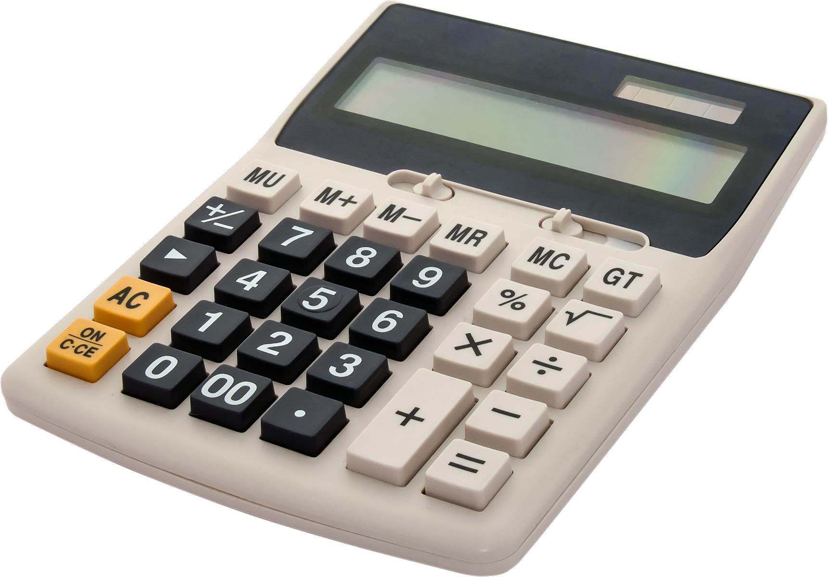
Building a GUI Calculator using Tkinter in Python—Project1
NEXTHIKES IT S OLUTIONS
By
CHETHANA S.S

Slide 2
Introduction to Building a GUI Calculator
The project, assigned by Next Hikes IT Solutions, is titled "Building a GUI Calculator Using PyQT in Python." However, I faced several challenges with this library, such as issues with installation, execution, and user-friendliness. Therefore, I used the Tkinter library to implement the GUI calculator.
Why Use Tkinter for Python GUI?
Tkinter is the standard GUI toolkit for Python, making it an excellent choice for developers. It comes pre-installed with most Python distributions, ensuring easy access for users. Furthermore, Tkinter applications are cross-platform, meaning they can run seamlessly on Windows, Mac and Linux systems.
Tkinter's straightforward approach allows beginners to easily create GUI applications. Its simple methods enable users to design windows, buttons, and other widgets with minimal coding, making it ideal for those who are new to programming.
Nexthikes IT Solutions

Slide 3
SETTING UP THE ENVIRONMENT
Install Python
Verify Tkinter Installation
Choose an IDE(Visual studio code)
Create Your First Tkinter Application
Nexthikes IT Solutions

Slide 4
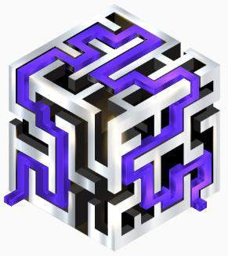
Designing the Calculator Interface
Creating a User – Friendly Calculator Layout with Tkinter
Importing Tkinter
importing the Tkinter library to access its features for building the GUI.
Defining the Layout
Utilizing the grid system, this section outlines how to effectively place buttons and the display for optimal user interaction.
Button Configuration
Buttons are created with specific commands
Creating the Main Window
This component establishes the main application window,
setting its title to 'Nexthikes Scientific Calculator'.
Entry Display
The entry widget serves as the display area for user inputs and results
Nexthikes IT Solutions

Slide 5
Sources and references
Used to implement GUI Scientific calculator
GeeksforGeeks
https://www.geeksforgeeks.org/python-dynamic-gui-calculator-using-tkinter-module/
Javapoint
https://www.javatpoint.com/gui-calculator-using-python
Python Documentation
https://www.tutorialspoint.com/simple-gui-calculator-using-tkinter-in-python
YouTube
https://www.youtube.com/watch?v=BM_MlI6MySY
Nexthikes IT Solutions

Slide 6
Summary and Conclusion
What I have learnt from this GUI Scientific calculator implementation??
→Programming Concepts:
Mastery of basic programming concepts such as loops, conditionals, and functions.
Exposure to handling events like button clicks.
→GUI Design:
Understanding layout management (grids, frames, etc.) for arranging components.
Working with widgets like buttons, labels, and input fields.
→Framework/Library Proficiency:
Familiarity with the library used for the GUI (e.g., Tkinter in Python, JavaFX, etc.).
Knowledge of integrating logic with the GUI.
→Debugging Skills:
Improved debugging techniques for identifying and resolving GUI and functionality errors.
→Problem-Solving:
Applying problem-solving skills to break down calculator functions (e.g., handling operations and edge cases like division by zero).
→Software Development Principles:
Modularizing code to separate logic from the user interface.
Writing reusable and maintainable code.
Nexthikes IT Solutions

Slide 7
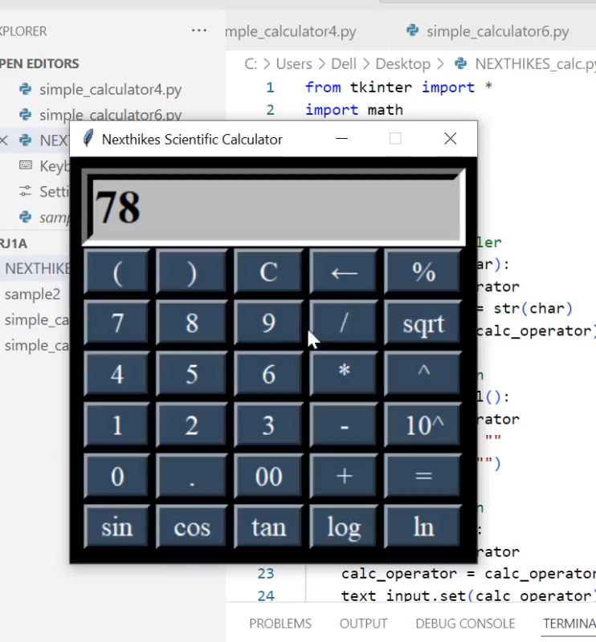
GUI CALCULATOR
Working Video : Click on the play button to see the operation

Slide 8

Thank You.
FAB
CHETHANA S S
chethanaindpur@gmail.com
www.nexthikes.com

